Slide 1
The LuGre Friction Model*
Auralius Manurung - ME - Universitas Pertamina
2020
*C. Canudas de Wit, H. Olsson, K. J. Astrom, and P. Lischinsky, “A new model for control of systems with friction,” IEEE Trans. Automat. Contr., vol. 40, no. 3, pp. 419–425, Mar. 1995.

Slide 2
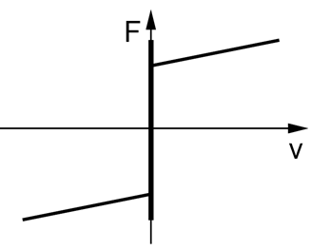
Friction Components
Break-away (stiction) → Nonlinear, the sign is direction dependent
Columb → Constant, the sign is direction dependent
Viscous → Linear
Viscous
Stiction
Columb

Slide 3
Static vs Dynamic Friction Models
Dynamic Friction | Static Friction
Dahl | Karnopp
LuGre
What are the differences?

Slide 4
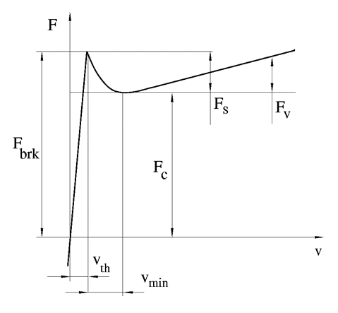
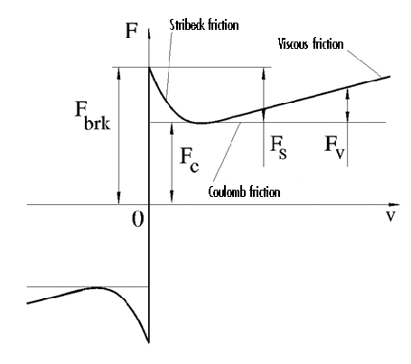
Stribeck Curve
discontinuous
Continuous
(with a slope)
http://ch.mathworks.com/help/physmod/simscape/ref/translationalfriction.html

Slide 5

Stribeck Curve
$v_{TH}$ : linear region velocity threshold (from ${10}^{−4}$ to ${10}^{−6}$ m/s)
$F_{c}$ = Columb friction
$F_{br}$ = Stiction friction / break-away friction
$F_{v}$ = Viscous friction

Slide 6
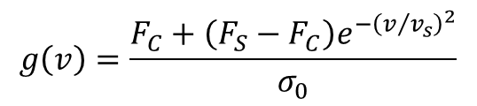
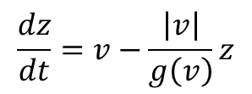
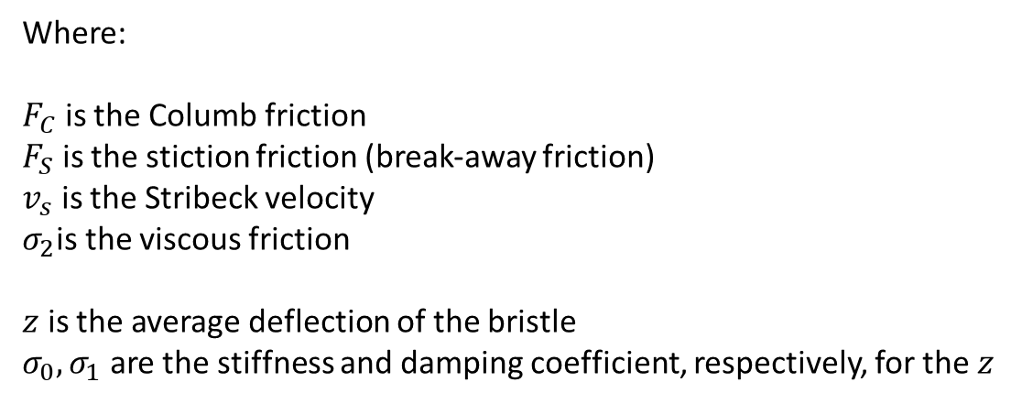
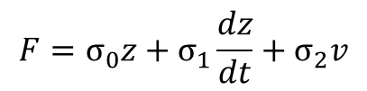
Implementation - MATLAB
$$g\left(v\right)=\frac{F_{C}+\left(F_{S}−F_{C}\right)e^{−{\left(v/{v_{s}}\right)}^{2}}}{σ_{0}}$$
Where:
$F_{C}$ is the Columb friction
$F_{S}$ is the stiction friction (break-away friction)
$v_{s}$ is the Stribeck velocity
$σ_{2}$is the viscous friction
$z$ is the average deflection of the bristle
$σ_{0}, σ_{1}$ are the stiffness and damping coefficient, respectively, for the $z$
$$\frac{dz}{dt}=v−\frac{\left|v\right|}{g\left(v\right)}z$$
$$F=σ_{0}z+σ_{1}\frac{dz}{dt}+σ_{2}v$$
C. Canudas de Wit, H. Olsson, K. J. Astrom, and P. Lischinsky, “A new model for control of systems with friction,” IEEE Transactions on Automatic Control, vol. 40, no. 3, pp. 419–425, Mar. 1995, [Online]. Available: http://ieeexplore.ieee.org/document/704999/.

Slide 7
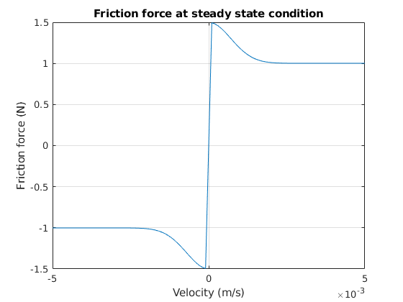
Frictio Force at Steady State Condition

Slide 8
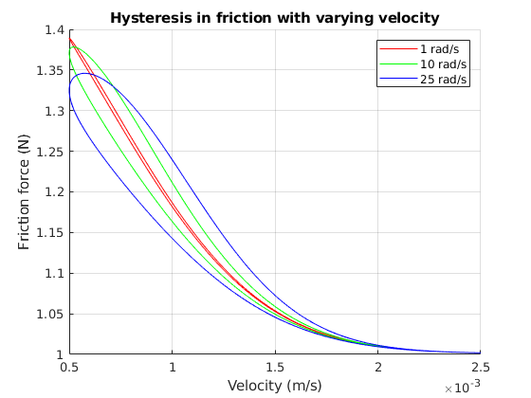
Hysteresis in Friction with Varying Velocity

Slide 9
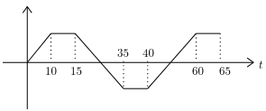
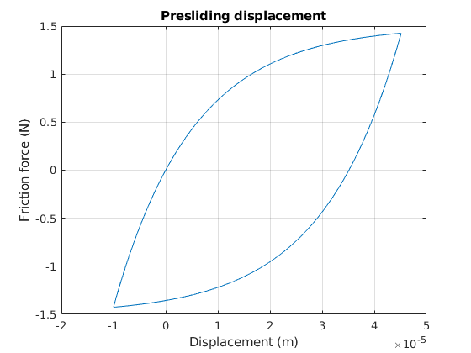
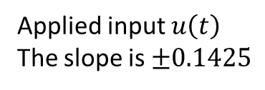
Presliding Displacement
Applied input $u\left(t\right)$
The slope is $±0.1425$

Slide 10
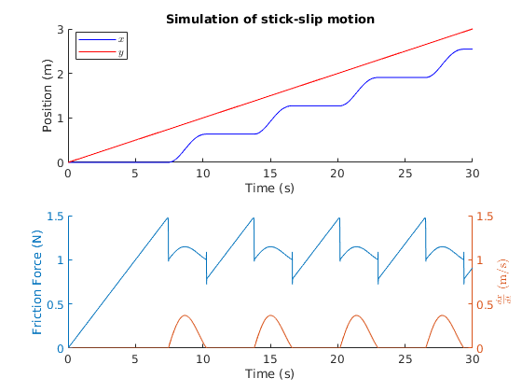
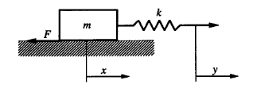
Stick-slip Motion

Slide 11
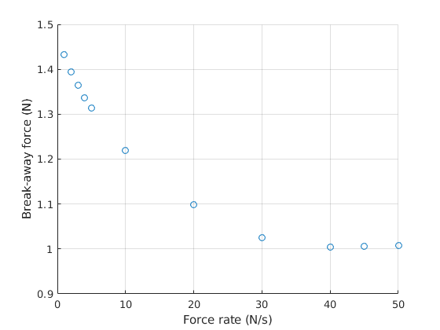
Force Rate vs Break-Away Force
Ramp force inputs with several different rates are applied until a movement is detected.

Slide 12
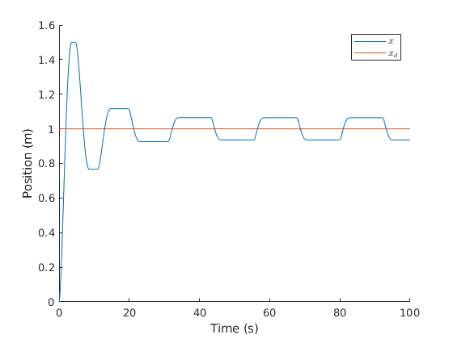

PID Control and Hunting Phenomenon
$K_{P}=3$, $K_{I}=4$, $K_{D}=6$

